Slide 1

Sum it up!

Slide 2

Our Goal Save graduate students, workers, employers research time!

Slide 3

Research takes 50% - 75% of our time!
Studies find that close to 75% of the time taken for producing something is spend on research!
Information in today’s world is ever growing and we need a way to deal with this.

Slide 4

Our application will summarize any text you need in seconds!
Our Tool To Summarize Text

Slide 5
The Team Made by students for students and workers!
Telerik
Martin
Ivona
Vladi
Pesho
Chrome Extension and Model
Machine Learning Models and Algorithms
Project Manager
Machine Learning Models and Algorithms
Chrome Extension and Model

Slide 6
Milestones A bit more left to tackle ; )
First Step
Hack End
Training the model and tweaking the hyperparameters
C
Reasearch and choose the right machine learning models and algorithms
Friday |  | Saturday |  | Sunday |  | Future
More Coding
Use it for everything we can think of!
Implementing the models and finding suitable training data

Slide 7
How our tool works
Step 3
Step 2
Process the data trough Seq2seq model using Encoder and Decoder network and feeding the model
Step 1
Convert the text to word embeddings vectors
Extract text content from a web page

Slide 8

Technology Stack

Slide 9
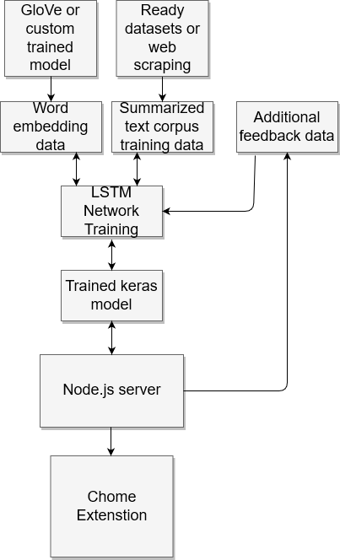
Application structure

Slide 10

Word embeddings
What is GloVe?
Why do we use it?
The advantages

Slide 11
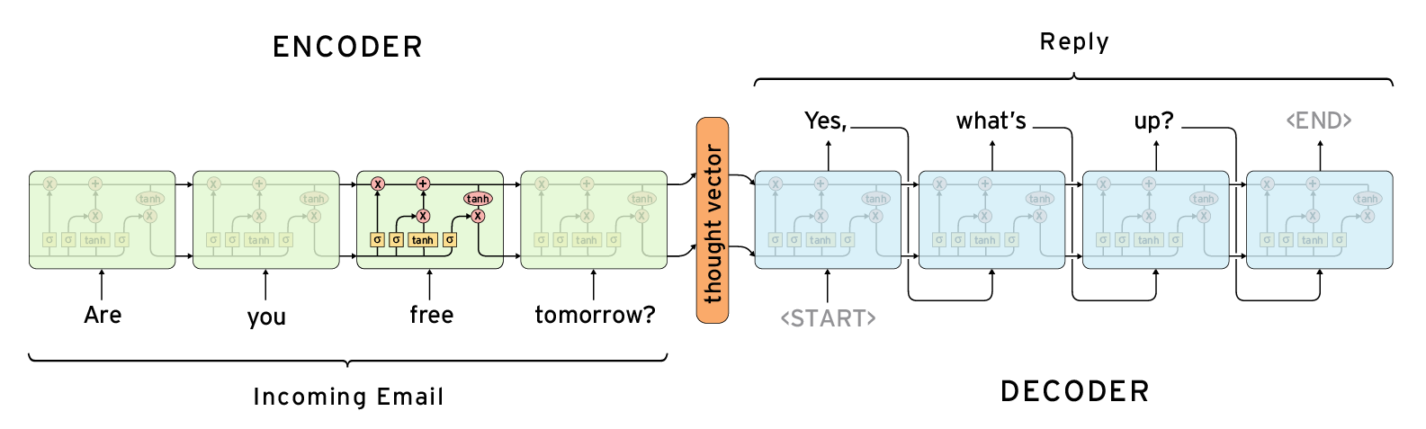
Neural network model
Seq2Seq
Recurrent LSTMNN
Attention based model
Encoder-decoder
How does it work?

Slide 12
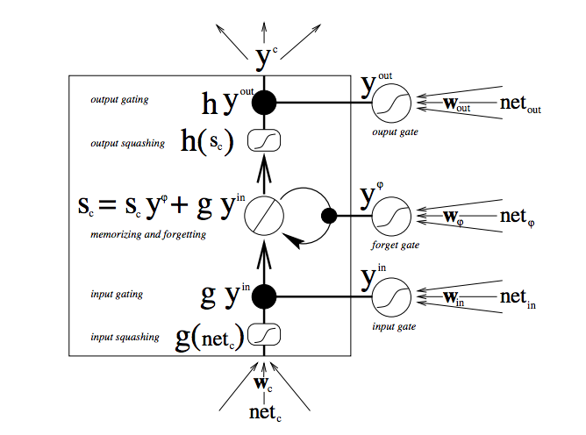
LSTM Cell
The main building block of the model
Quite an old architecture

Slide 13

Used technologies
Keras
Tensorflow
Python
NLTK
Web scraping tools
Node.js and chrome

Slide 14

Demo

Slide 15
Thanks for your attention! Questions & discussion

